Slide 1
Internet Applications
CSCE 3420

Slide 2
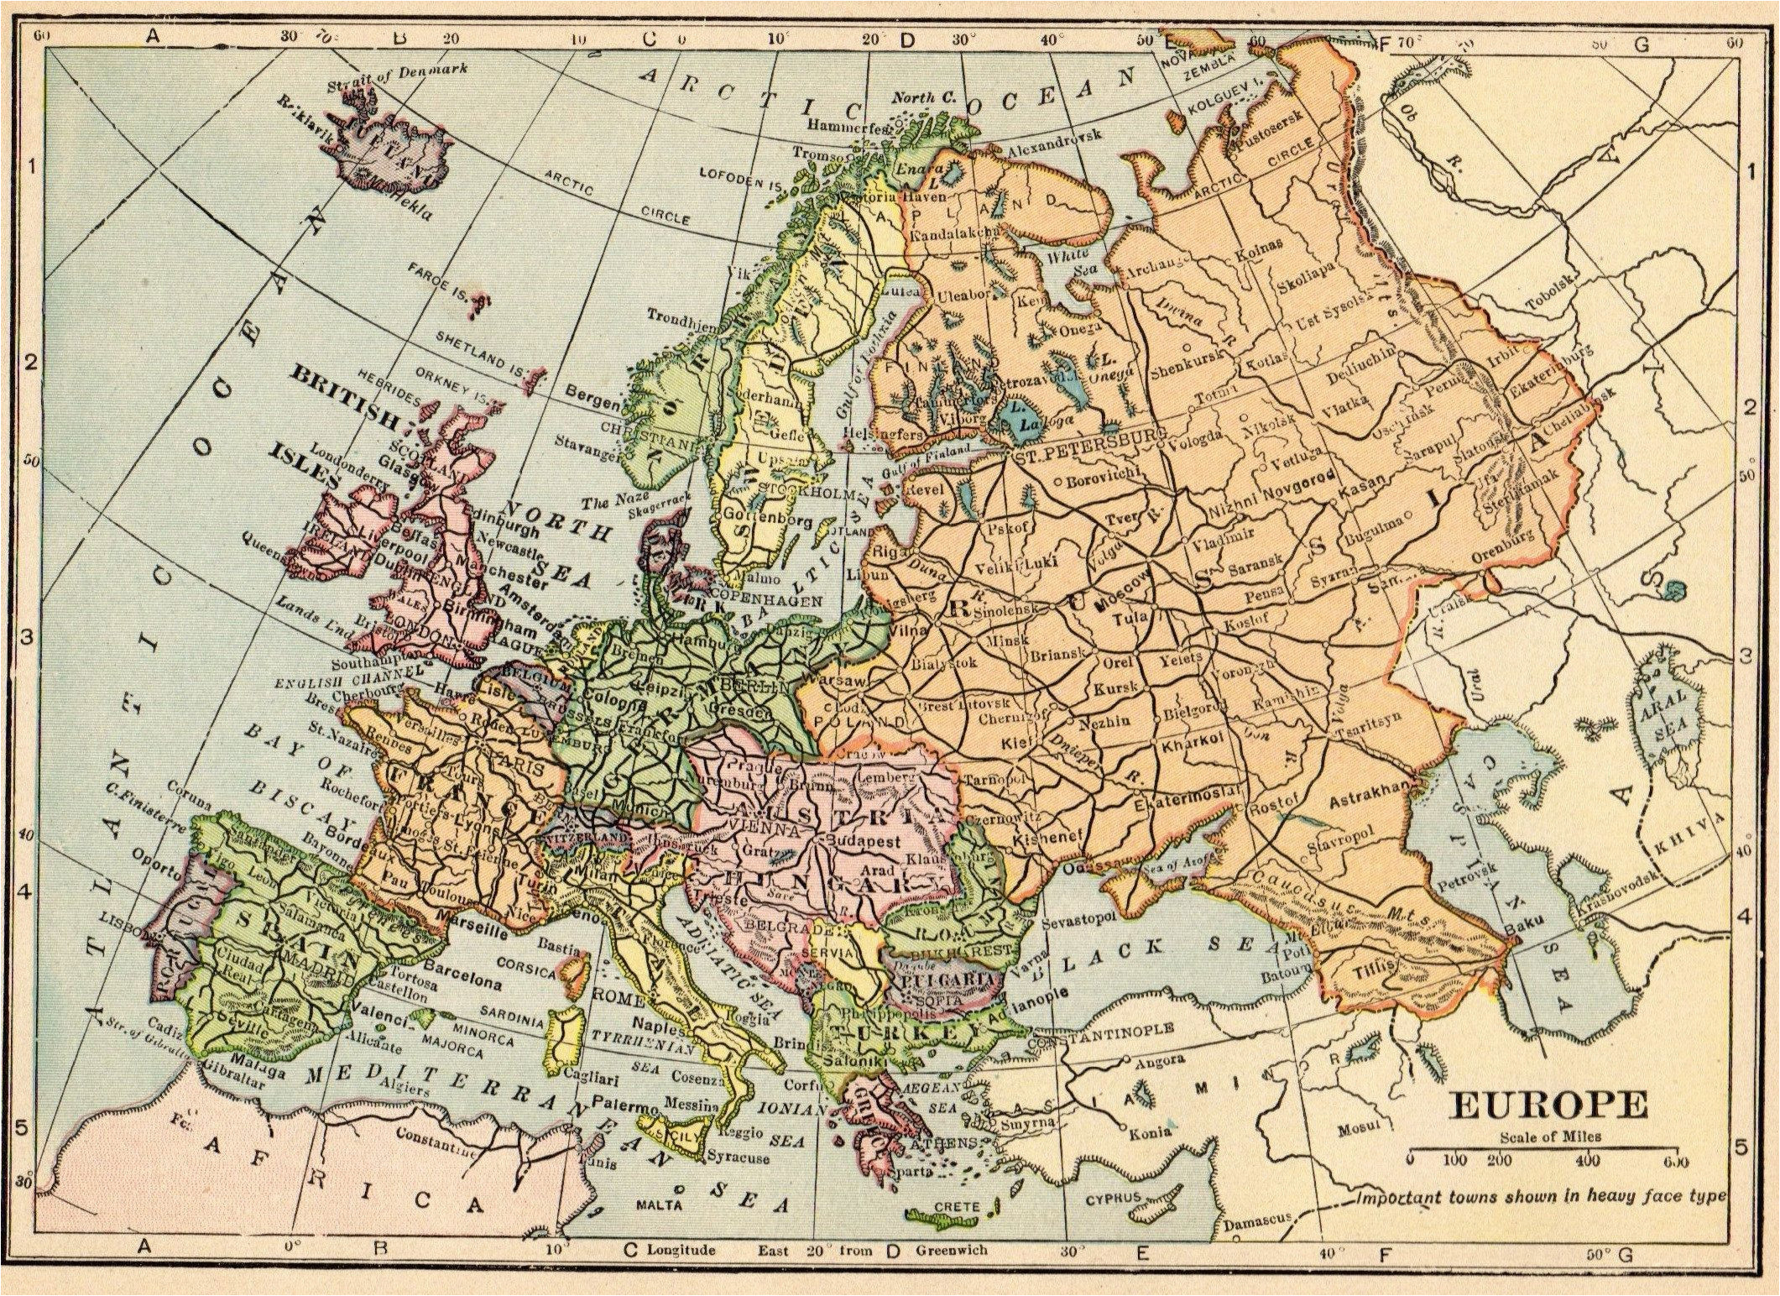
Europe around WW II
Note the interconnecting ‘web’ of highways

Slide 3
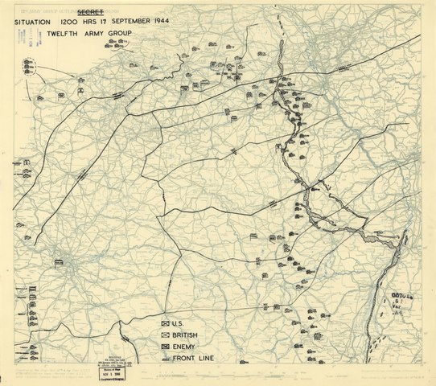
Allies Supply Lines Sept 1944
Note how the Allied Forces took advantage of that web

Slide 4
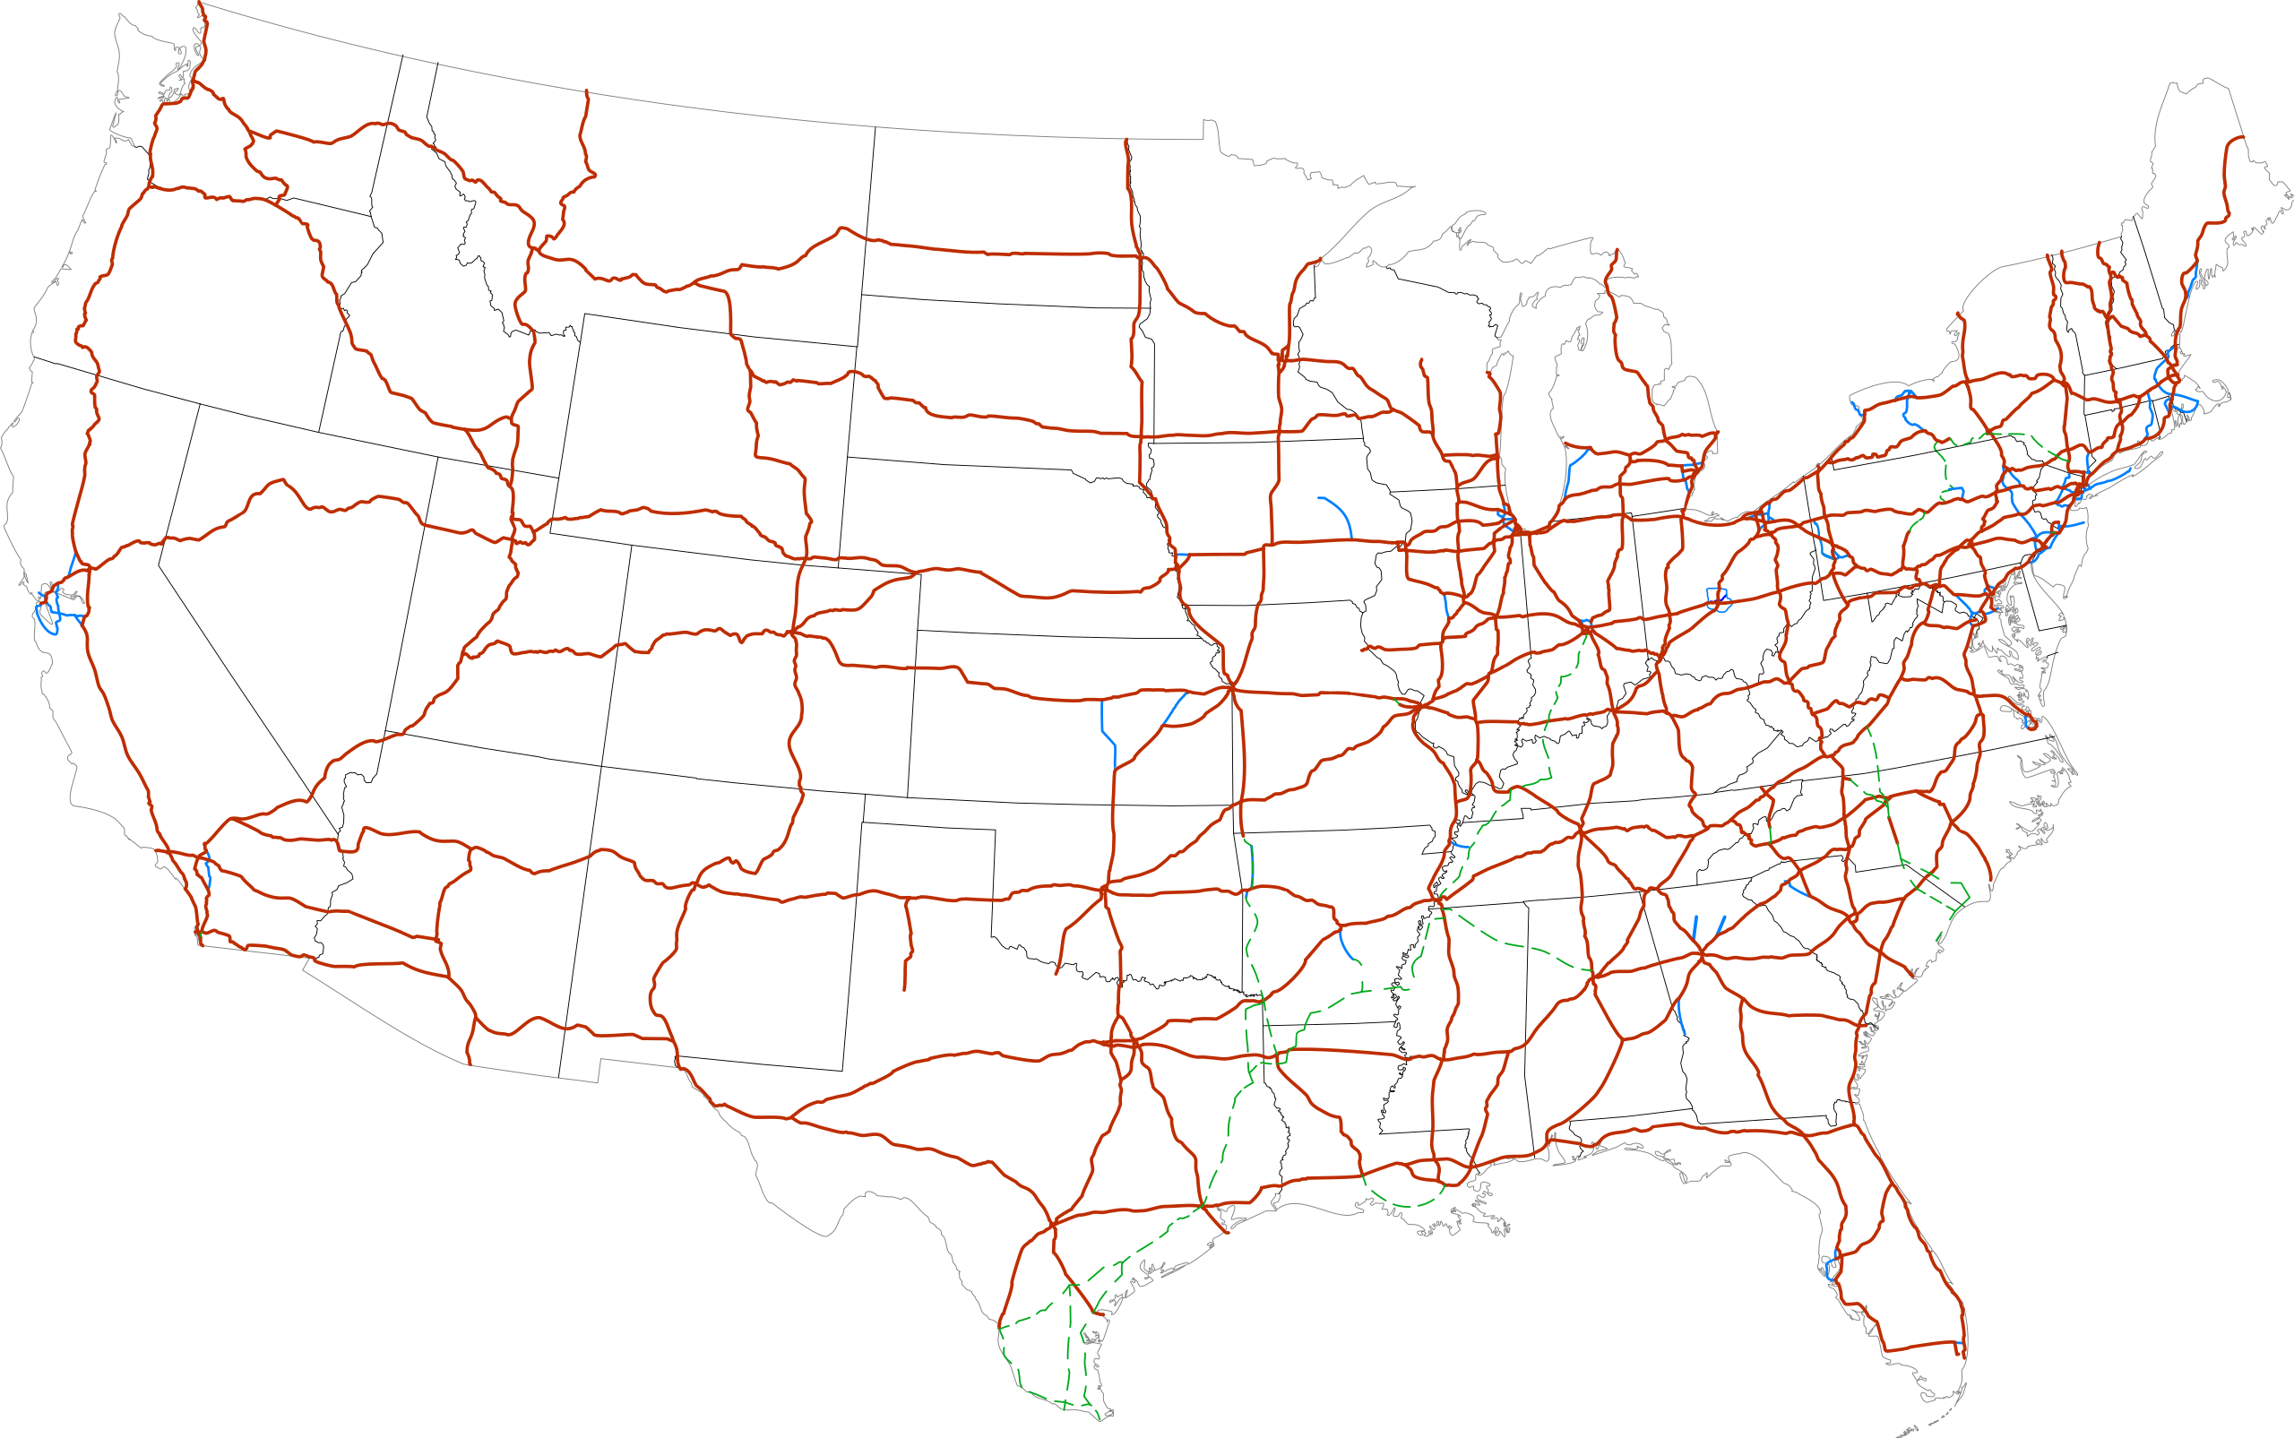
US Interstate System Thank you, Europe and General Eisenhower
National System of Interstate and Defense Highways

Slide 5
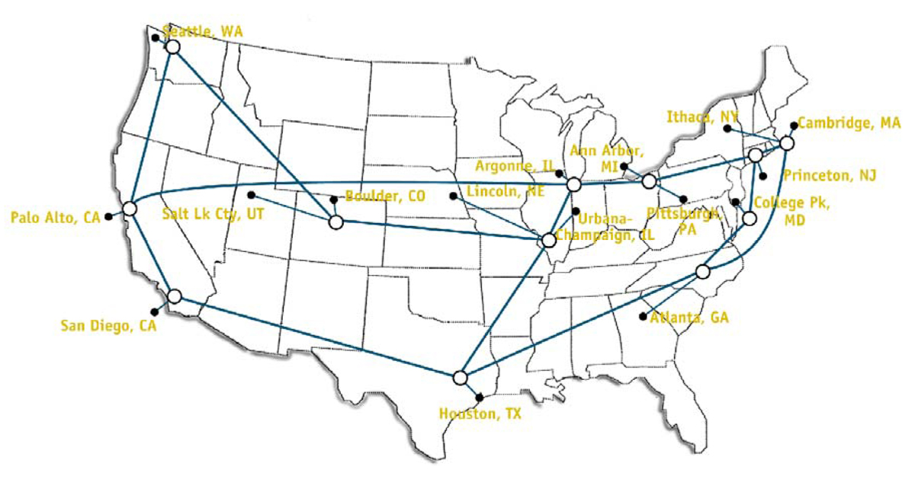
T3 Network 1992

Slide 6
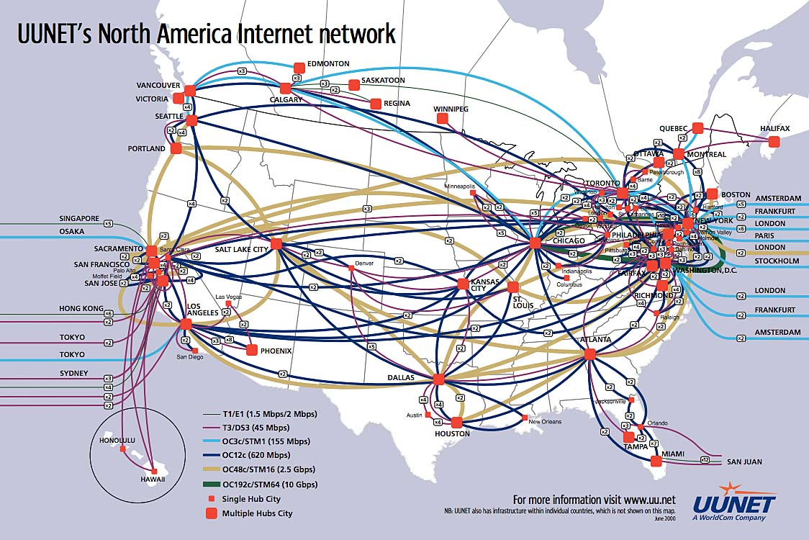
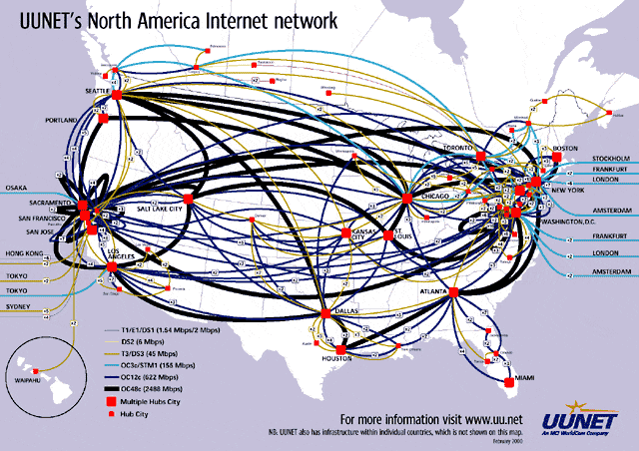
You’ve come a long way baby

Slide 7
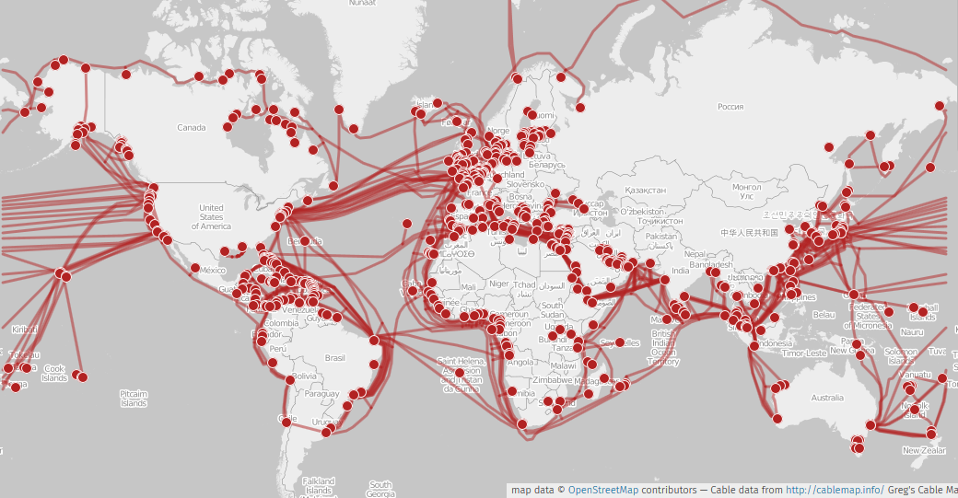
Undersea Cables

Slide 8
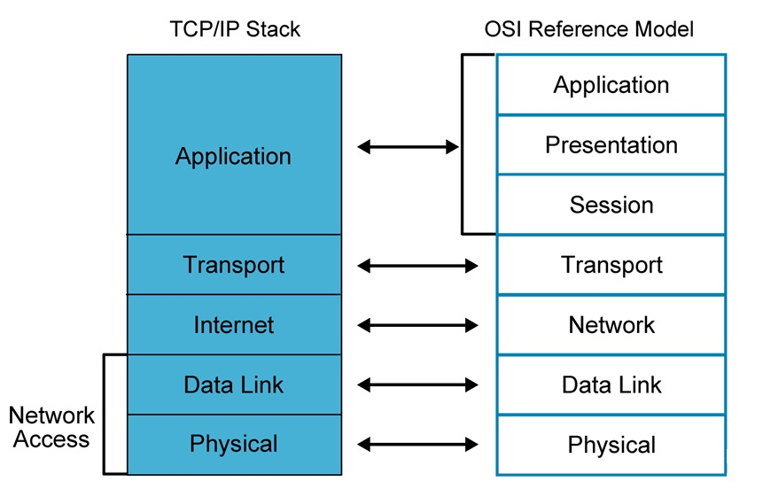
Comparing TCP/IP Stack with OSI Reference Model
https://www.cloudflare.com/learning/ddos/glossary/open-systems-interconnection-model-osi/

Slide 9
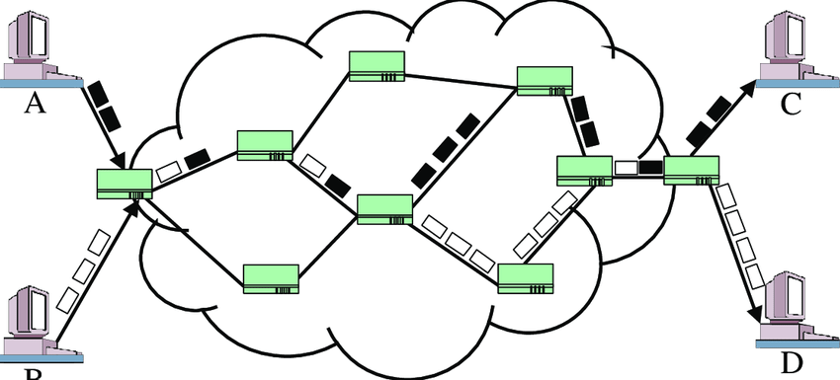
Packet Switching Network

Slide 10
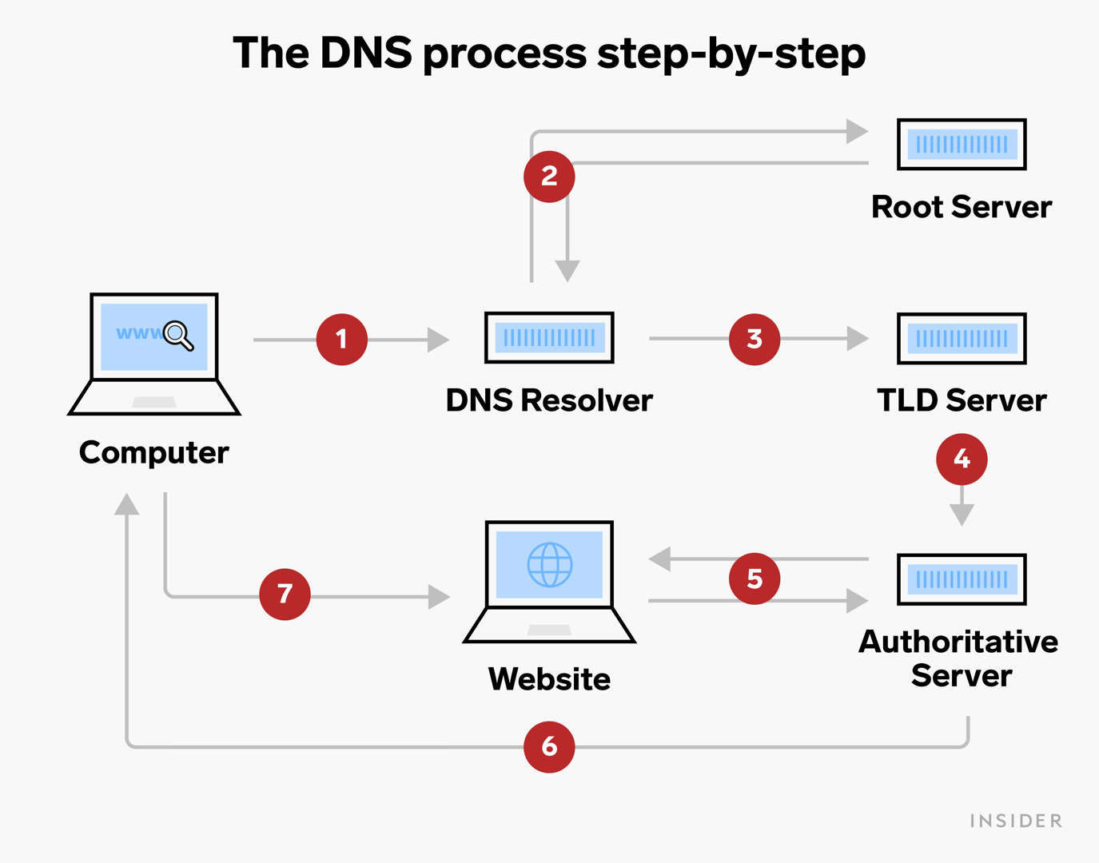
From URL to IP address
Domain Name System
Translates your www.Facebook.com to a physical IP address
31.13.93.35
Enter this into your browser. It will load Facebook

Slide 11
Directions to Discovery Park CHEC
I ask for directions to Discovery Park CHEC
Converts speech to text
Uses language analysis to determine my request is for directions
Passes that request off to the designated server
The GPS server determines if it is a valid destination
Converts Discovery Park CHEC to a Geo Location
Determines the fastest (and alternate routes to DP)
Presents the individual steps on my dashboard

Slide 12
Name that Port
Ports 20 and 21: File Transfer Protocol (FTP). FTP is for transferring files between a client and a server.
Port 22: Secure Shell (SSH). SSH is one of many tunneling protocols that create secure network connections.
Port 25: Simple Mail Transfer Protocol (SMTP). SMTP is used for email.
Port 53: Domain Name System (DNS). DNS matches human-readable domain names to machine-readable IP addresses
Port 80: Hypertext Transfer Protocol (HTTP). HTTP is the protocol that makes the World Wide Web possible.
Port 123: Network Time Protocol (NTP). NTP allows computer clocks to sync with each other, a process that is essential for encryption.
Port 443: HTTP Secure (HTTPS). HTTPS is the secure and encrypted version of HTTP.

Slide 13
What does a server do
Does an infinite loop
Listens for a request on a particular port
Responds to a request
File, HTML, JSON, JavaScript
Browser makes a request and waits for that response.
Until recently this was all HTML (we see more JSON now)
Causing the page to reload (or be dynamically created)
Notes:
Minecraft port 25565
MS SQL 1443

Slide 14
Terms
Client – the browser
Server – Destination resource to respond to Client request
Usually single purpose (web server and DB not on same machine)
HTML – Hyper Text Markup Language
HTTP – is the Hyper Text Transport Protocol
Stateless – doesn’t remember you from one visit to the next
User port 80

Slide 15
Terms
Cookies - How Amazon tracks you
A ‘session’ is created and a cookie is saved on your computer
Which can be queried or given to the server to associate you with your cart in the database
CRUD – Create, Read, Update, Delete

Slide 16
HTTP Verbs How we communicate with a server
HTTP Verb Corresponding CRUD action
GET Read
POST Create
PUT/PATCH Update
DELETE Delete

Slide 17
HTTP Response Codes
Informational responses (100–199)
Successful responses (200–299)
Redirects (300–399)
Client errors (400–499)
Server errors (500–599)
https://developer.mozilla.org/en-US/docs/Web/HTTP/Status

Slide 18
Have you ever seen a 418 error?
100 Continue
101 Switching Protocols
103 Early Hints
200 OK
201 Created
202 Accepted
203 Non-Authoritative Information
204 No Content
205 Reset Content
206 Partial Content
300 Multiple Choices
301 Moved Permanently
302 Found
303 See Other
304 Not Modified
308 Permanent Redirect
307 Temporary Redirect
400 Bad Request
401 Unauthorized
402 Payment Required
403 Forbidden
404 Not Found
405 Method Not Allowed
406 Not Acceptable
407 Proxy Authentication Required
408 Request Timeout
409 Conflict
410 Gone
411 Length Required
412 Precondition Failed
413 Payload Too Large
414 URI Too Long
415 Unsupported Media Type
416 Range Not Satisfiable
417 Expectation Failed
418 I'm a teapot
422 Unprocessable Entity
425 Too Early
426 Upgrade Required
428 Precondition Required
429 Too Many Requests
431 Request Header Fields Too Large
451 Unavailable For Legal Reasons
500 Internal Server Error
501 Not Implemented
502 Bad Gateway
503 Service Unavailable
504 Gateway Timeout
505 HTTP Version Not Supported
506 Variant Also Negotiates
507 Insufficient Storage
508 Loop Detected
510 Not Extended
511 Network Authentication Required

Slide 19
cURL
curl https://www.crapfilter.com
curl -o index.html https://www.crapfilter.com
curl -X POST http://www.crapfilter.com -d 'term=mars'
curl -X POST http://www.crapfilter.com -d 'term=mars' -o mars.html
curl --request GET \
--url 'https://imdb8.p.rapidapi.com/title/find?q=mars' \
--header 'x-rapidapi-host: imdb8.p.rapidapi.com' \
--header 'x-rapidapi-key: 498ed225bamshcd02cf5559e10edp179d21jsn59b140b93ec5'

